Slide 1



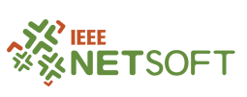
Towards Network-Aware Resource Provisioning in Kubernetes for Fog Computing applications
José Santos, Tim Wauters, Bruno Volckaert, Filip de Turck
IEEE Conference on Network Softwarization (NETSOFT 2019)
24 – 28 June, 2019 – Paris, France

Slide 2
50 billion!

Slide 3



But how “big” 50 billion really is?
1 million seconds
1 billion seconds
50 billion seconds
12 days
30 years
16 centuries

Slide 4
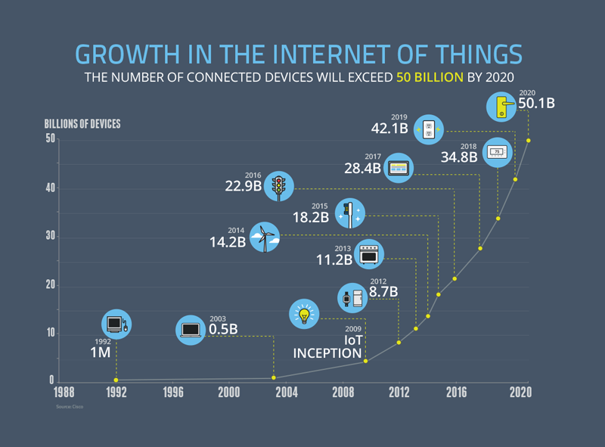

Slide 5
Outline
How can we deal with the massive growth of IoT?
How can we improve Kubernetes Scheduling Features?
How can we evaluate our approach?

Slide 6

“If you think that the internet has changed your life, think again. The Internet of Things is about to change it all over again!” Brendan O’Brien, Aria Systems co-founder

Slide 7

What exactly is Kubernetes?
Container Orchestration Platform
Robust & Reliable
Scaling up Containers (Docker)
Massive Open Source Community

Slide 8
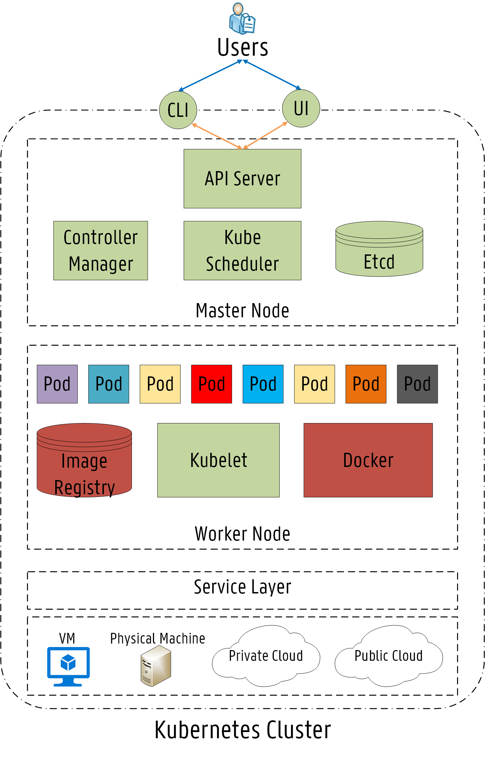
Kubernetes Architecture

Slide 9
Outline
How can we deal with the massive growth of IoT?
How can we improve Kubernetes Scheduling Features?
How can we evaluate our approach?

Slide 10
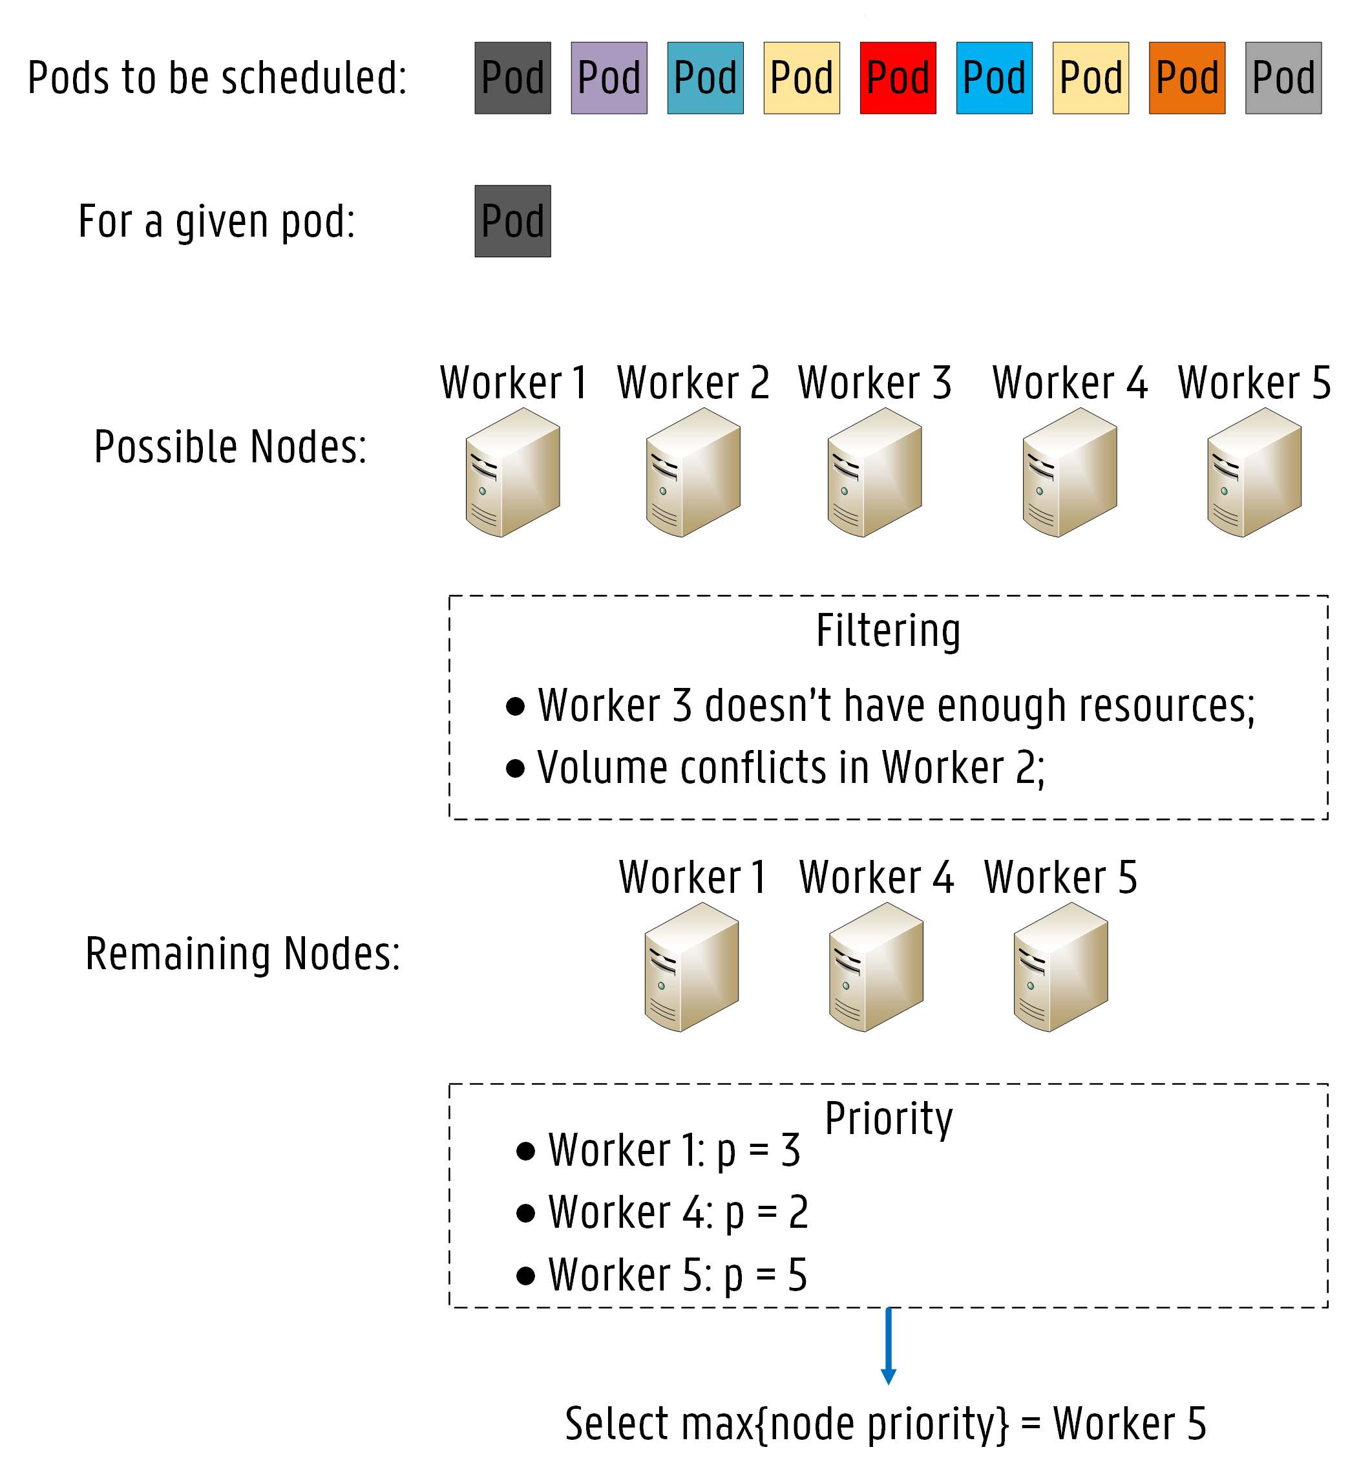
Kube-Scheduler (KS)
How does it work?
1
Node Filtering
2
Node Priority Calculation

Slide 11

Kube-Scheduler (KS)
Fast Decision Time
Easily extensible
Lack of specific rules
Only CPU and RAM

Slide 12
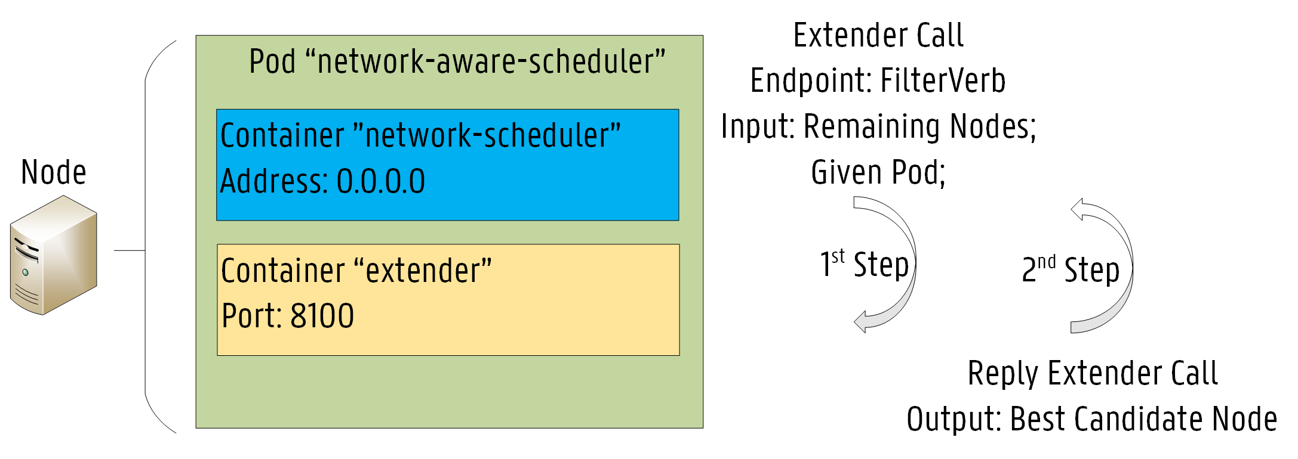
Network-Aware Scheduler (NAS)
Implemented by extending KS:
1
Node Filtering
2
Minimization of RTT
Bandwidth Conservation

Slide 13
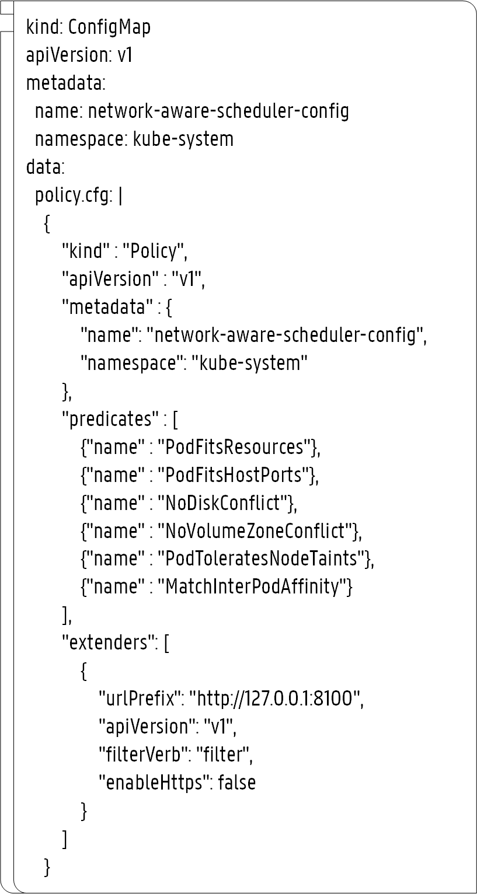
YAML Files
Scheduler Policy Configuration
Policy Name
1
Predicates
2
Extender
3

Slide 14
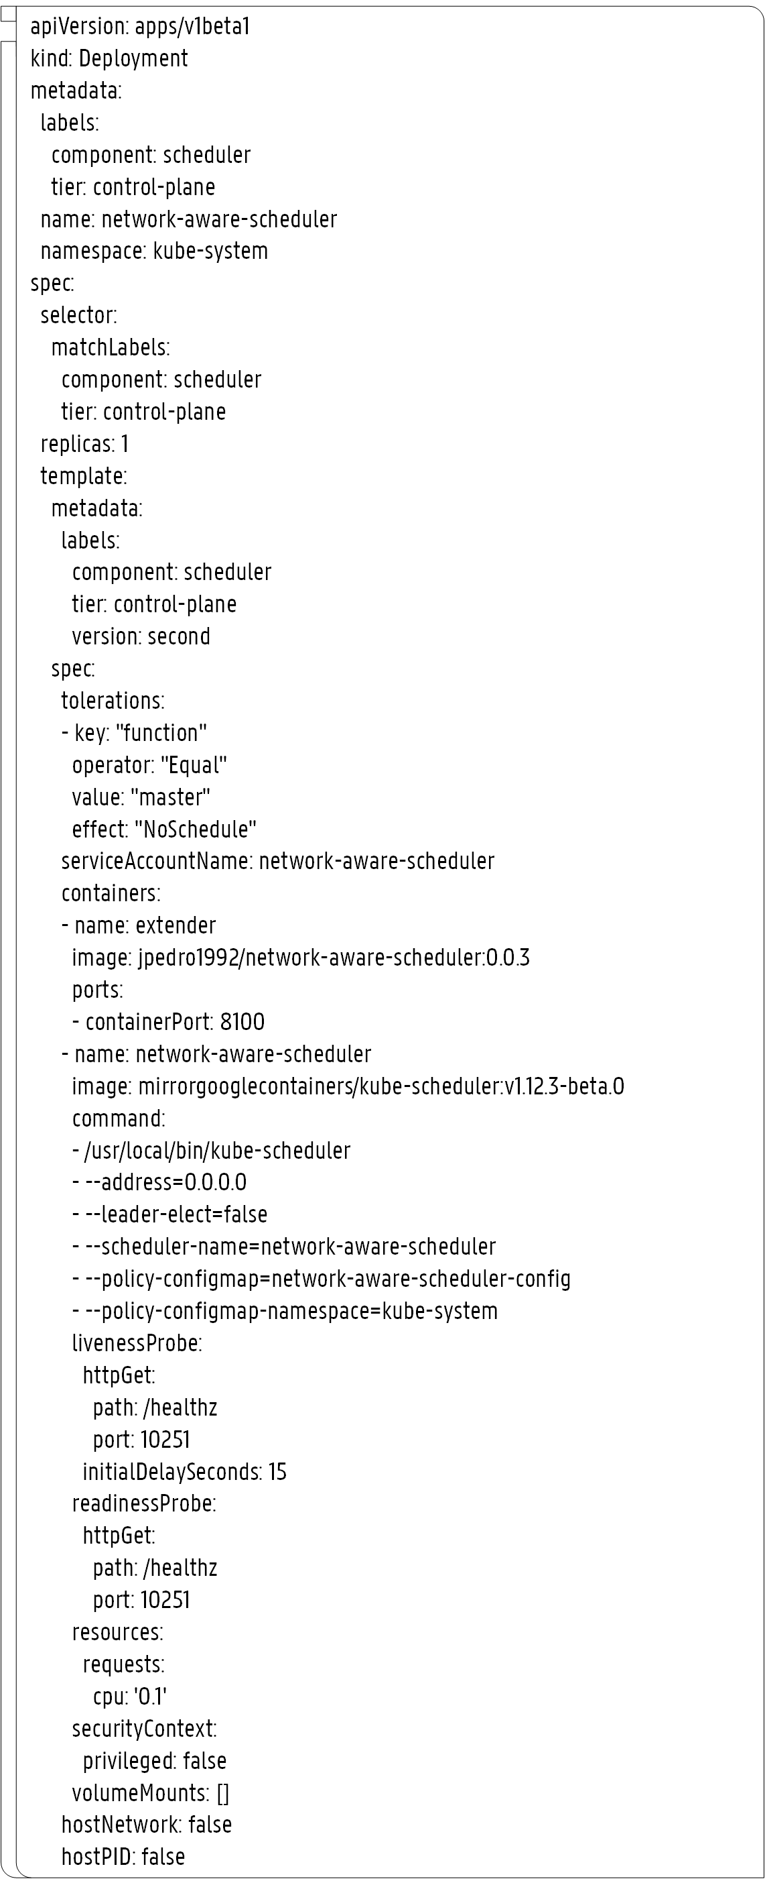
YAML Files
Account Configuration
1
Scheduler Deployment
Extender Container
2
KS Container
3

Slide 15
Outline
How can we deal with the massive growth of IoT?
How can we improve Kubernetes Scheduling Features?
How can we evaluate our approach?

Slide 16
Evaluation Approach

Slide 17
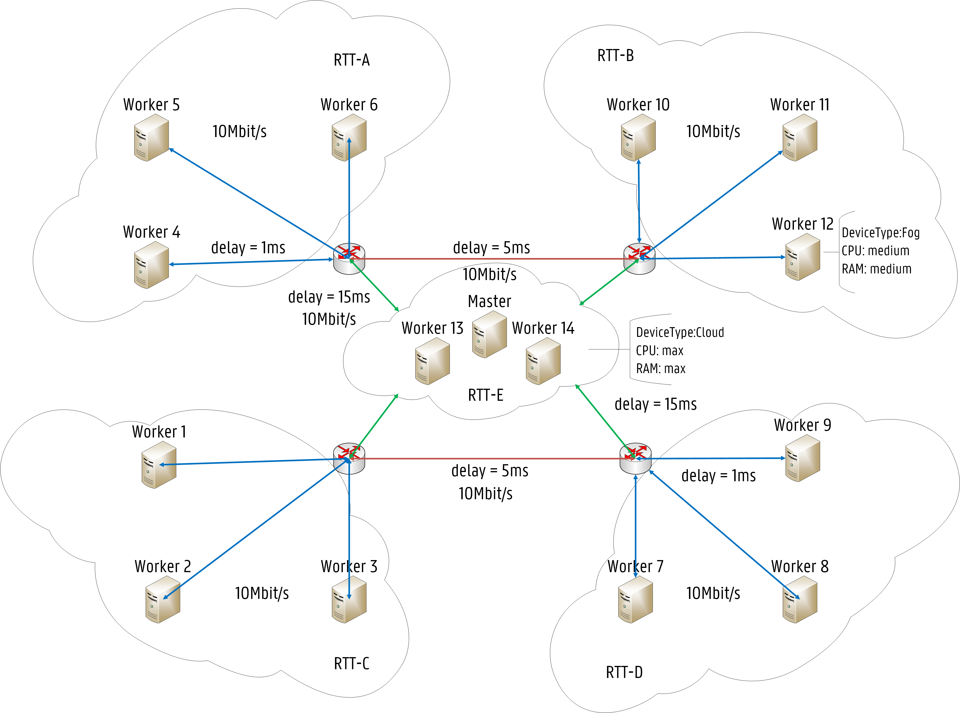
Evaluation Scenario
RTT Labels (e.g. Worker 1)
1
RTT-A: 64.0 ms
2
RTT-B: 64.0 ms
3
RTT-C: 2.0 ms
4
RTT-D: 14.0 ms
5
RTT-E: 32.0 ms
6
Av. Bandwidth: 10Mbit/s

Slide 18
Services
Deployment Properties (e.g. Birch-api)
Replication Factor: 4
Target Location: RTT-A
Min. Bandwidth: 2.5 Mbit/s
100/500m CPU
128/256Mi RAM
Pod Anti-Affinity rule
Birch
Birch-api
Birch-cassandra
1
2
Robust
Robust-api
Kmeans
Kmeans-api
Kmeans-cassandra
3
4
Isolation
Isolation-api

Slide 19
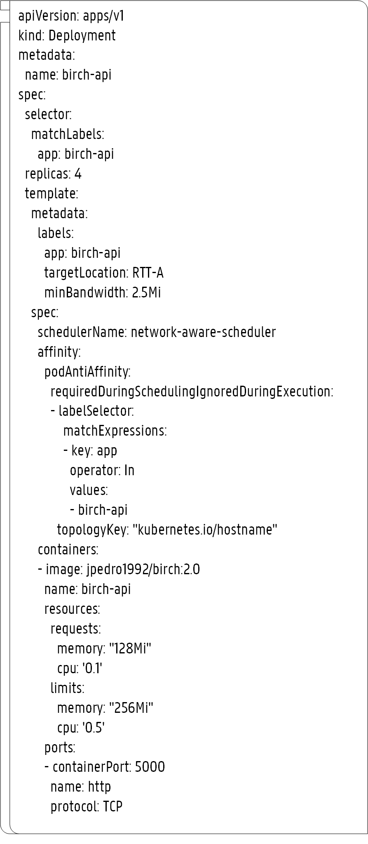
YAML Files
Birch-api Service Configuration
1
Replication Factor: 4
Target Location: A
Min. Bandwidth: 2.5 Mbit/s
2
3
Scheduler
Affinity Rules
4
Resource Requests
5

Slide 20
Results

Slide 21
Execution Time
Extender Decision
Scheduling Decision
Pod Startup Time
KS
0 ms
2.14 ms
2.02 s
NAS
4.82 ms
6.44 ms
2.10 s

Slide 22
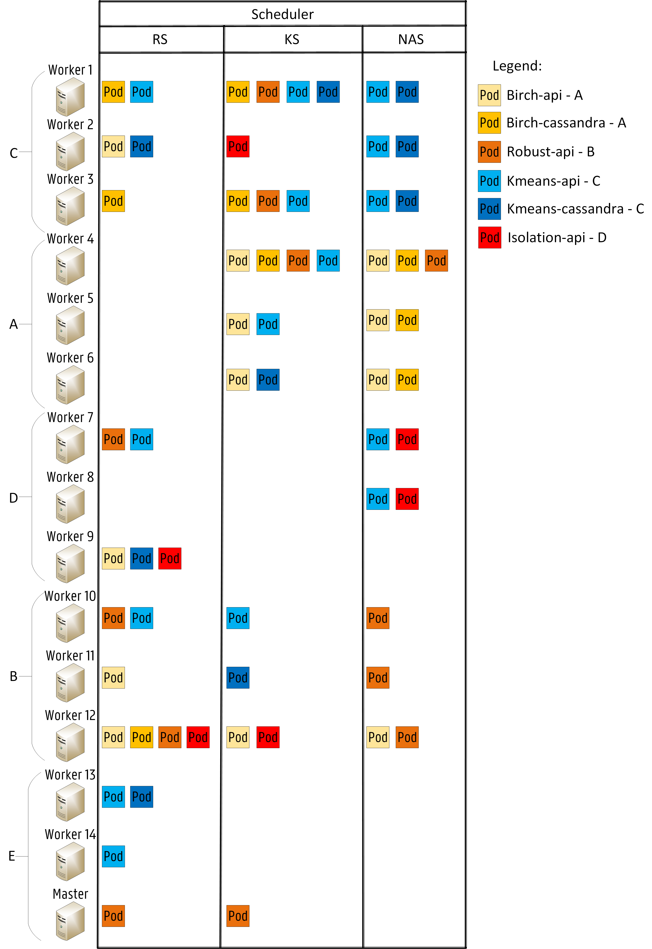
Allocation Scheme

Slide 23
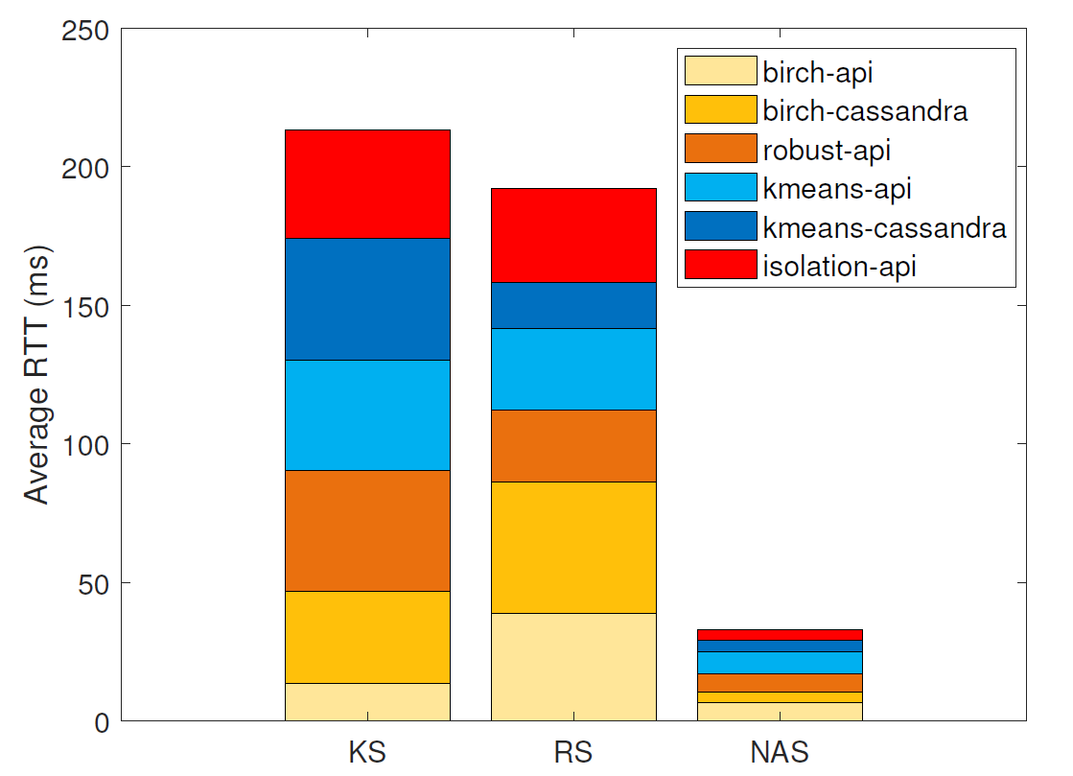
Average RTT
80%

Slide 24
Conclusions
Allocation decisions based on the network infrastructure
Validated in Kubernetes.
Results:
80% reduction of network latency
Future Work:
Deployment in a real Smart City

Slide 25

Thank you for your attention!
Questions?
José Santos
Ghent University – imec, IDLab
josepedro.pereiradossantos@UGent.be

Slide 26
Random Scheduler (RS)
Also implemented by extending KS
1
Node Filtering
2
Random pick
Notes:
The random selection of the node is, in fact, a random pick after the KS filters out the inappropriate nodes:

Slide 27
RTT labels
Node | RTT-A | RTT-B | RTT-C | RTT-D | RTT-E
Mater | 32 ms | 32 ms | 32 ms | 32 ms | 4 ms
Worker 1 | 64 ms | 64 ms | 4 ms | 14 ms | 32 ms
Worker 2 | 64 ms | 64 ms | 4 ms | 14 ms | 32 ms
Worker 3 | 64 ms | 64 ms | 4 ms | 14 ms | 32 ms
Worker 4 | 4 ms | 14 ms | 64 ms | 64 ms | 32 ms
Worker 5 | 4 ms | 14 ms | 64 ms | 64 ms | 32 ms
Worker 6 | 4 ms | 14 ms | 64 ms | 64 ms | 32 ms
Worker 7 | 64 ms | 64 ms | 14 ms | 4 ms | 32 ms
Worker 8 | 64 ms | 64 ms | 14 ms | 4 ms | 32 ms
Worker 9 | 64 ms | 64 ms | 14 ms | 4 ms | 32 ms
Worker 10 | 14 ms | 4 ms | 64 ms | 64 ms | 32 ms
Worker 11 | 14 ms | 4 ms | 64 ms | 64 ms | 32 ms
Worker 12 | 14 ms | 4 ms | 64 ms | 64 ms | 32 ms
Worker 13 | 32 ms | 32 ms | 32 ms | 32 ms | 4 ms
Worker 14 | 32 ms | 32 ms | 32 ms | 32 ms | 4 ms

Slide 28
Deployment Properties
Service Name | Pod Name | CPU Req/Limit (Mi) | RAM Req/Limit (Mi) | Min. Bandwidth (Mbit/s) | Repl. Factor | Target Location | Dependencies
Birch | birch-api | 100/500 | 128/256 | 2.5 | 4 | A | birch-cassandra
 | birch-cassandra | 500/1000 | 1024/2048 | 5 | 3 |  | birch-api
Robust | robust-api | 200/500 | 256/512 | 2 | 4 | B | none
Kmeans | kmeans-api | 100/500 | 128/256 | 2.5 | 5 | C | kmeans-cassandra
 | kmeans-cassandra | 500/1000 | 1024/2048 | 5 | 3 |  | kmeans-api
Isolation | isolation-api | 200/500 | 256/512 | 1 | 2 | D | none

Slide 29
Execution Time
Scheduler | Extender Decision | Scheduling Decision | Binding Operation | Pod Startup Time
KS | - | 2.14 ms | 162.7 ms | 2.02 s
RS | 5.32 ms | 7.71 ms | 178.2 ms | 3.04 s
NAS | 4.82 ms | 6.44 ms | 173.1 ms | 2.10 s

